Slide 1
Contents
Introduction
Literature Survey
Design Scheme
Testing, Analysis, And Evaluation
Socio-economic Issues Associated With The Project
Engineering Tools And Standards
Conclusion

Slide 2
Introduction
In the era of smart living, the integration of technology into our homes has become essential for enhancing convenience, energy efficiency, and overall well-being. The Efficient Home Management System (EHMS) leverages the power of Raspberry Pi Pico W, a microcontroller with built-in wireless capabilities, and Thonny, a versatile Internet of Things (IoT) platform, to create a seamless and intelligent home automation solution.

Slide 3
Literature Survey
Creating an efficient home management system using Raspberry Pi Pico and thonny involves integrating hardware and software components to monitor and control various aspects of a home. Below is a literature survey that covers relevant topics for developing such a system:

Slide 4
Design Scheme
Raspberry Pi Pico W:
Central control unit.
Sensors:
Temperature, humidity, light, motion, gas, door/window sensors.
Actuators:
Relays, motor control, smart plugs.
Thonny Platform:
User interface for real-time control and monitoring.
Sensor Data Acquisition:
Raspberry Pi Pico W collects data from sensors.
Data Processing:
Analyzes sensor data for patterns and triggers.
Actuator Control:
Manages appliances, blinds, and devices based on rules.
Communication with Thonny:
Establishes a secure connection for real-time updates.
User Interface:
Blynk app displays data and allows user control.
Security Measures:
Encrypts communication, user authentication.
Energy Optimization:
Uses low-power modes and smart scheduling.

Slide 5
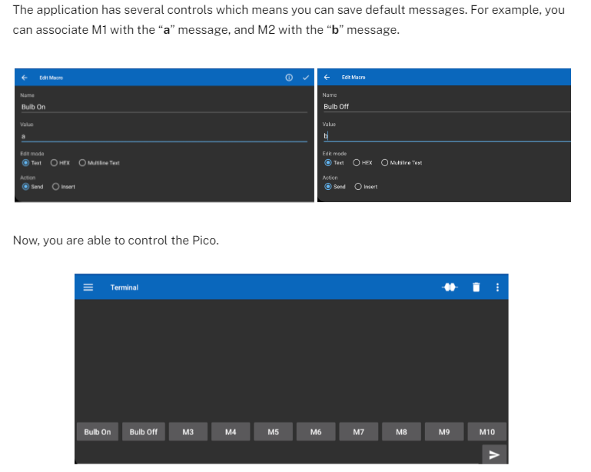
Testing
You can write the following commands.
“a” and “b” messages to control the first Relay.
“c” and “d” messages to control the second Relay.
“e” and “f” messages to control the third Relay.
“g” and “h” messages to control the fourth Relay.

Slide 6
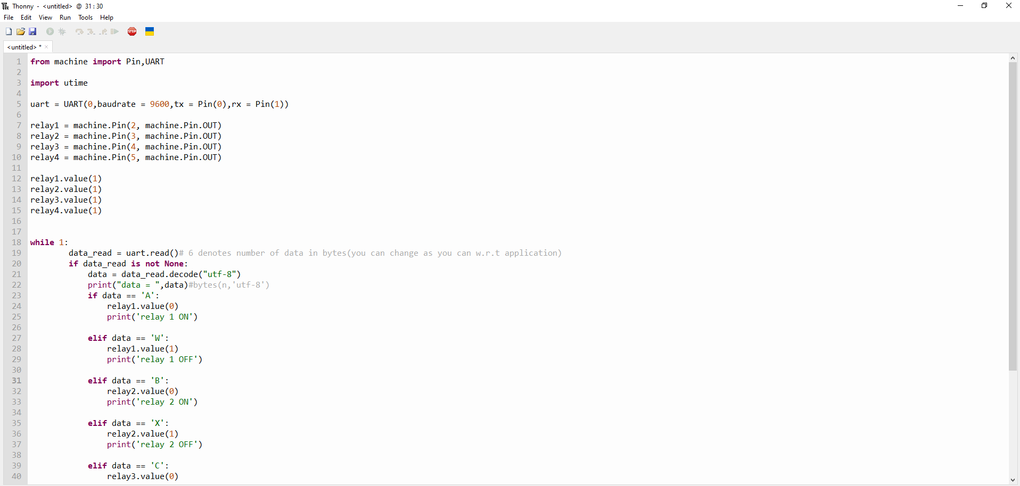

Results, Analysis and Evaluation
Python code on thonny to be saved on raspberry pi pico

Slide 7
Socio-economic Issues Associated With The Project
Affordability and Accessibility:
Ensure the system is affordable and accessible across various socio-economic backgrounds.
Digital Inclusion:
Address potential exclusion of individuals with limited digital literacy or technology access.
Energy Efficiency and Cost Savings:
Evaluate economic benefits, ensuring the system provides cost savings and justifies initial investment.
Job Displacement and Skills:
Consider potential job displacement and assess skill requirements for system installation and maintenance.
Data Privacy and Security:
Implement robust security measures to protect user data and address privacy concerns.
Community Engagement:
Involve the community in planning to ensure the system meets actual needs and avoids social disparities.
Support Local Businesses:
Assess impacts on local businesses and collaborate to mitigate negative effects.
Health and Safety:
Ensure the system does not compromise health and safety standards.
Educational Opportunities:
Explore educational programs for digital literacy and technical skills related to the system.
Long-Term Maintenance:
Consider maintenance requirements and costs to sustain the system over time.
Regulatory Compliance:
Ensure compliance with local regulations and standards.
Social Equity and Inclusion:
Promote social equity and inclusion, avoiding exacerbation of existing inequalities.

Slide 8
Engineering Tools And Standards
Engineering Tools and Standards for Efficient Home Management System with Raspberry Pi Pico W:
Raspberry Pi Pico :
Utilize the Raspberry Pi Pico microcontroller for efficient and cost-effective control of sensors and devices in the home management system.
Thonny Platform:
Leverage Thonny for seamless connectivity, real-time monitoring, and user-friendly interface development for the home automation system.
IoT Protocols (e.g., MQTT):
Implement standardized IoT protocols like MQTT for efficient communication between devices, ensuring interoperability and scalability.
Sensor Integration (e.g., Temperature, Motion):
Integrate various sensors (e.g., temperature, motion) using industry-standard interfaces to gather data for informed decision-making.
Programming Languages (e.g., Python):
Use programming languages like Python for Raspberry Pi development, ensuring code efficiency, readability, and community support.
Power Management Systems:
Employ power management systems to optimize energy usage, extending the life of connected devices and reducing environmental impact.
Security Standards (e.g., TLS/SSL):
Adhere to security standards like TLS/SSL to encrypt data transmission, ensuring the confidentiality and integrity of user information.
Home Automation Standards (e.g., Zigbee, Z-Wave):
Consider compatibility with home automation standards (e.g., Zigbee, Z-Wave) to enable seamless integration with other smart devices and systems.
Cloud Services (e.g., AWS, Google Cloud):
Integrate with cloud services (e.g., AWS, Google Cloud) for remote access, data storage, and analysis, enhancing system scalability and flexibility.
User Interface (UI) Design Standards:
Follow established UI design standards for Blynk 2.0 to create an intuitive and user-friendly interface, ensuring ease of use for homeowners.
Compliance with Regulatory Standards:
Adhere to relevant regulatory standards (e.g., data protection, safety) to ensure legal compliance and user trust.

Slide 9
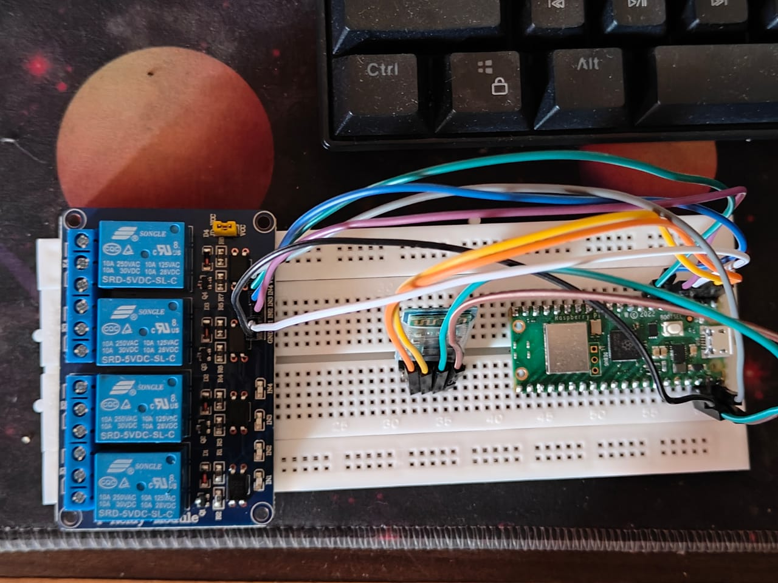
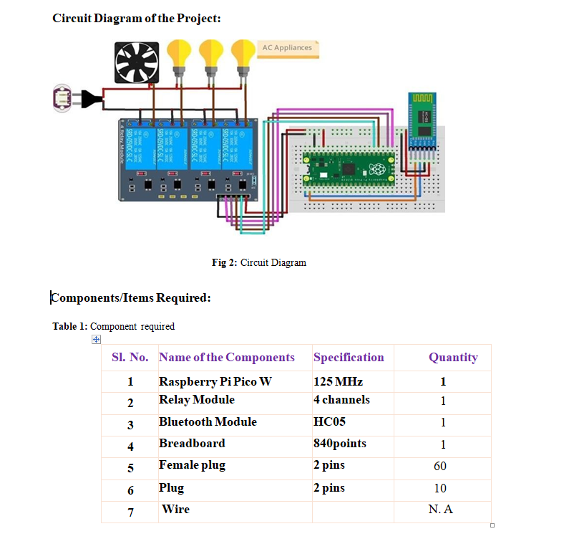
Conclusion
implementing an Efficient Home Management System with Raspberry Pi Pico offers potential benefits in energy efficiency and convenience. However, addressing affordability, digital inclusion, job displacement concerns, and ensuring robust data security are crucial for a positive impact. Prioritizing community engagement, education, and ethical implementation can maximize the system's potential while minimizing socio economic changes.
Breadboard wiring and inner model

Slide 10
References
https://www.instructables.com/Home-Automation-Using-Raspberry-Pi-Pico/
https://projectsfactory.in/product/raspberry-pi-pico-home-automation/ Youtube
https://www.youtube.com/watch?v=y191voKAPhg&ab_channel=ElectronicClinic
https://srituhobby.com/how-to-make-a-home-automation-system-with-raspberry-pi-pico-board/

